Slide 1
EMS Interoperability Task Force October 12, 2023
Patient History to EMS Flow
Notes:
This meeting is being recorded and will be posted. If you need anything removed from the recording, let us know.
Note change to moderated format, use hand raise feature to be acknowledged to speak.

Slide 2
Task Force Overview
Monthly, 2nd Thursday, 11a–12:30p MT
Nov 9, Dec 14 Dec 15 (ONC Annual Meeting / EMS Data Summit)
Topics:
Feb 16: Identifying data exchange partners and establishing relationships
Mar 9: Governmental, regulatory, and contractual environment
Apr 13: Regulatory environment and national networks recap
May 11: Sequence/workflow: SAFR design
Jun 8: Sequence/workflow
Jul 13: Standards and profiles overview
Specific standards and profiles to use in workflow:
Aug 10: EMS to Hospital
Sep 14: Hospital Outcomes to EMS
Oct 12: Patient History to EMS
Patient identification and record matching
Data elements to be shared and parsed
APIs

Slide 3
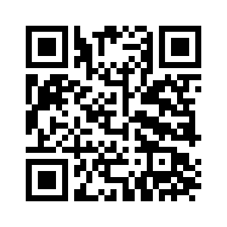
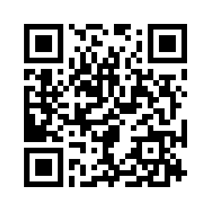
ONC Annual Meeting & EMS Data Summit
ONC Annual Meeting
EMS Data Summit
December 14–15, 2023
Washington DC
ONCannualmeeting.com
December 15, 12:00–3:30p ET
Washington DC and online
umarket.utah.edu/um2/nemsis
Notes:
https://www.oncannualmeeting.com/
https://umarket.utah.edu/um2/nemsis/

Slide 4
EMS Data Summit
This Summit will pick up with lessons learned from the 2020 EMS Data Summit and focus on improving the integration of standardized emergency medical services (EMS) data with hospital electronic medical records (EMRs) and health information exchanges (HIEs).
Challenges to address:
EMS at the interop table
Operations queries
Network participation
Funding
Notes:
Policy perspective
Also mention ONC letter

Slide 5
Today’s Topic
Standards and profiles to use for EMS to query for a patient’s medical records and retrieve a medical record.

Slide 6
Today’s Questions
What standards are profiles are used for querying for patient medical history data?
What standards and profiles are used for the content of patient medical records?

Slide 7
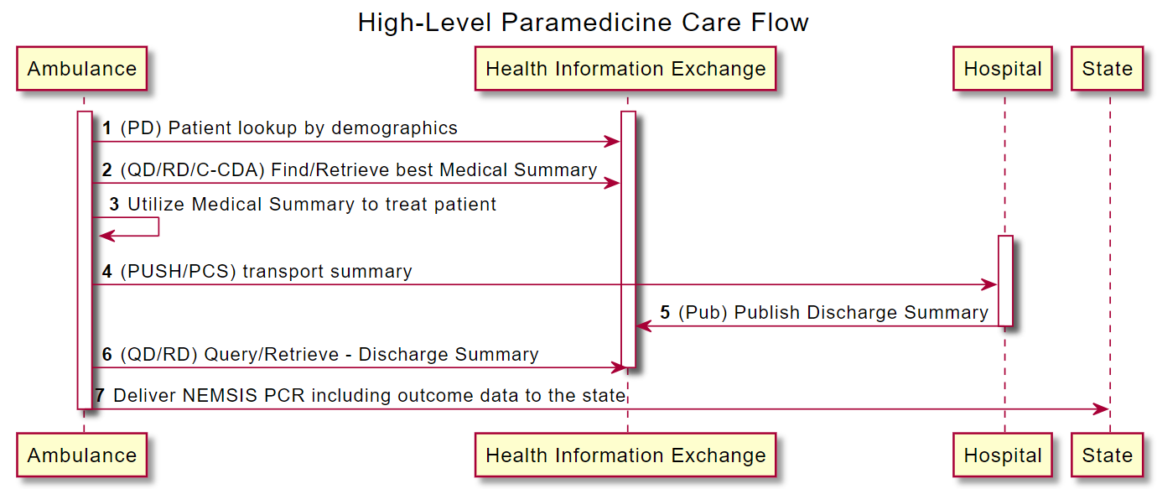
Patient History Information Flow

Slide 8
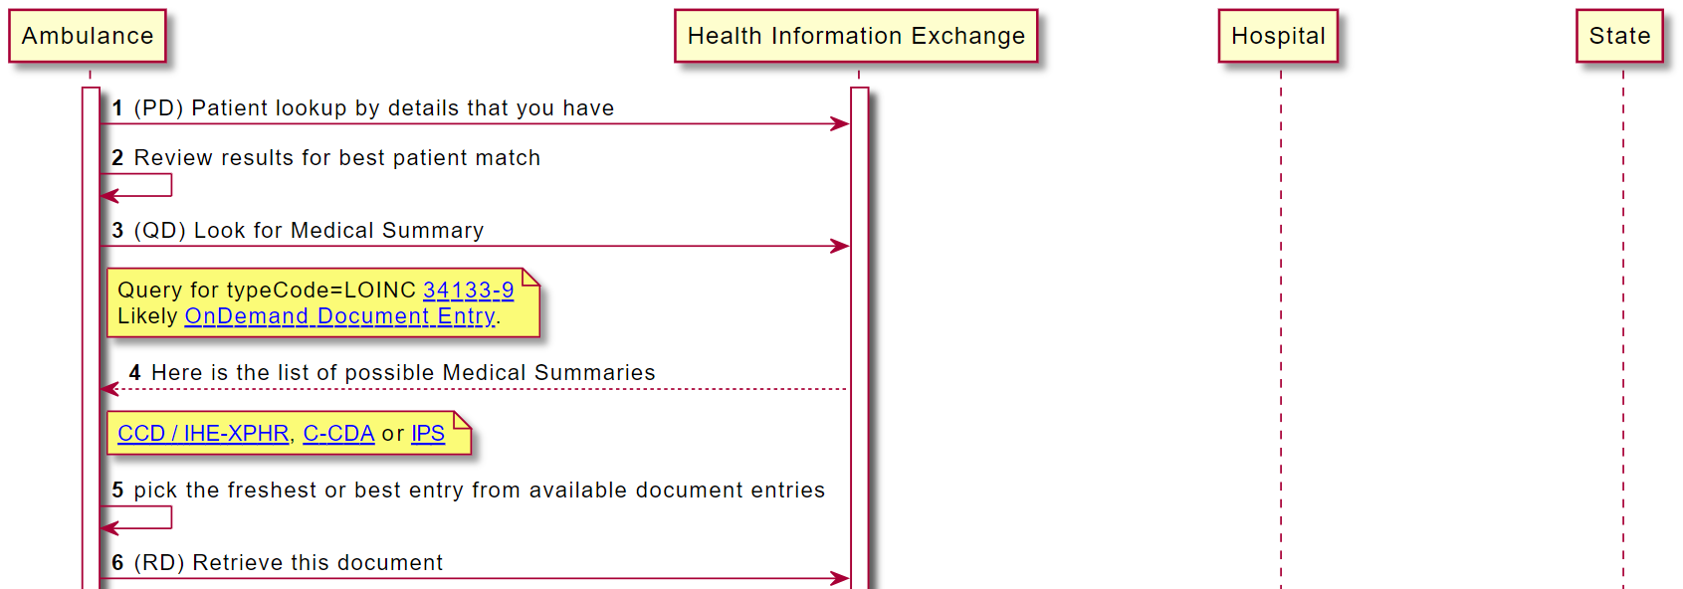
Notes:
Click on each link to illustrate
Note no direct involvement of the hospitals. EMS interacts with the exchange/network.

Slide 9
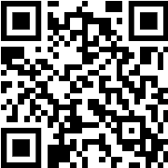
Did We Answer Today’s Question?
What standards are profiles are used for querying for patient medical history data?
What standards and profiles are used for the content of patient medical records?
Notes:
Give link to survey in chat:
https://forms.office.com/r/Z1ER9MqctE
We’ve added one more question to the survey: What do you think is the most important topic to address next in the EMS Interoperability Task Force?

Slide 10
Next Steps
Survey for today’s task force call
Task Force Email Group
groups.google.com/g/ems-task-force
Github Repository and Wiki (includes link to sequence diagram)
github.com/IHE/EMS
November 9 Task Force Topic: Patient identification
December: ONC Annual Meeting and EMS Data Summit
Notes:
November 9 Task Force topic: Patient identification and record matching

